Slide 1
Nevada Regional transmission coordination task force
Bruce Rew Senior Vice President Operations

Slide 2
Who we are

Slide 3
Our Beginning
In 1941, 11 member utilities pooled electricity to power aluminum plant at Jones Mill for critical defense
Maintained after WWII to continue benefits of regional coordination
Notes:
SPP’s story began just after the attack on Pearl Harbor in 1941, when America had an immediate need to build airplanes. Aluminum is made from bauxite, and Arkansas had the largest bauxite deposit in the nation. A plant was opened at Jones Mill, Ark., to produce aluminum around the clock.
Jones Mill required 120,000 kW of power to operate at full capacity, 24x7. However, the total power installed in the entire state of Arkansas was only 100,000 kW. There wasn’t enough time to build new power plants. On December 14, 1941, 11 regional utilities formed the Southwest Power Pool. The pooled power allowed Jones Mill to produce aluminum throughout the war. The original 11 companies in SPP were: Arkansas Power and Light, Louisiana Power and Light, Mississippi Power and Light, Southwestern Gas and Electric Company, Public Service Commission of Oklahoma, Nebraska Power and Light, Texas Power and Light, Southwestern Power and Light, Oklahoma Gas and Electric, Kansas Gas and Electric, and Empire District Electric.
After the war, SPP continued to exist as a voluntary organization because our members recognized the growing interdependence of the electric grid, and realized the benefit in coordinating with neighboring utilities. Since World War II, one of SPP’s key roles has been to bring its members together to discuss and make decisions about issues that impact the region.

Slide 4
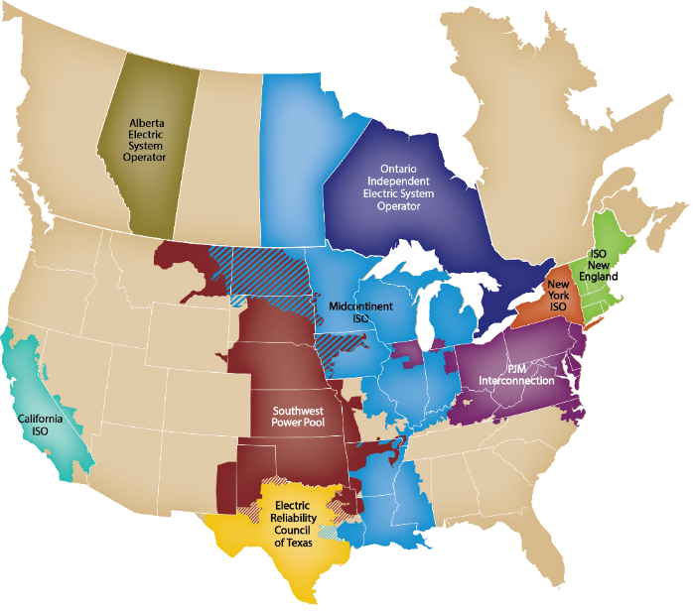
WHO IS SPP?
501(c)(6) nonprofit corporation
One of 9 regional grid operators
114 member companies in 14 states
“Air traffic control” for high-voltage grid
Balances supply and demand across region
Maintains reliable grid operations
Operates wholesale energy market
Plans future transmission needs
Spp does not
Own or operate grid infrastructure
Serve end-use customers
Set generation prices
Set retail electricity rates

Slide 5
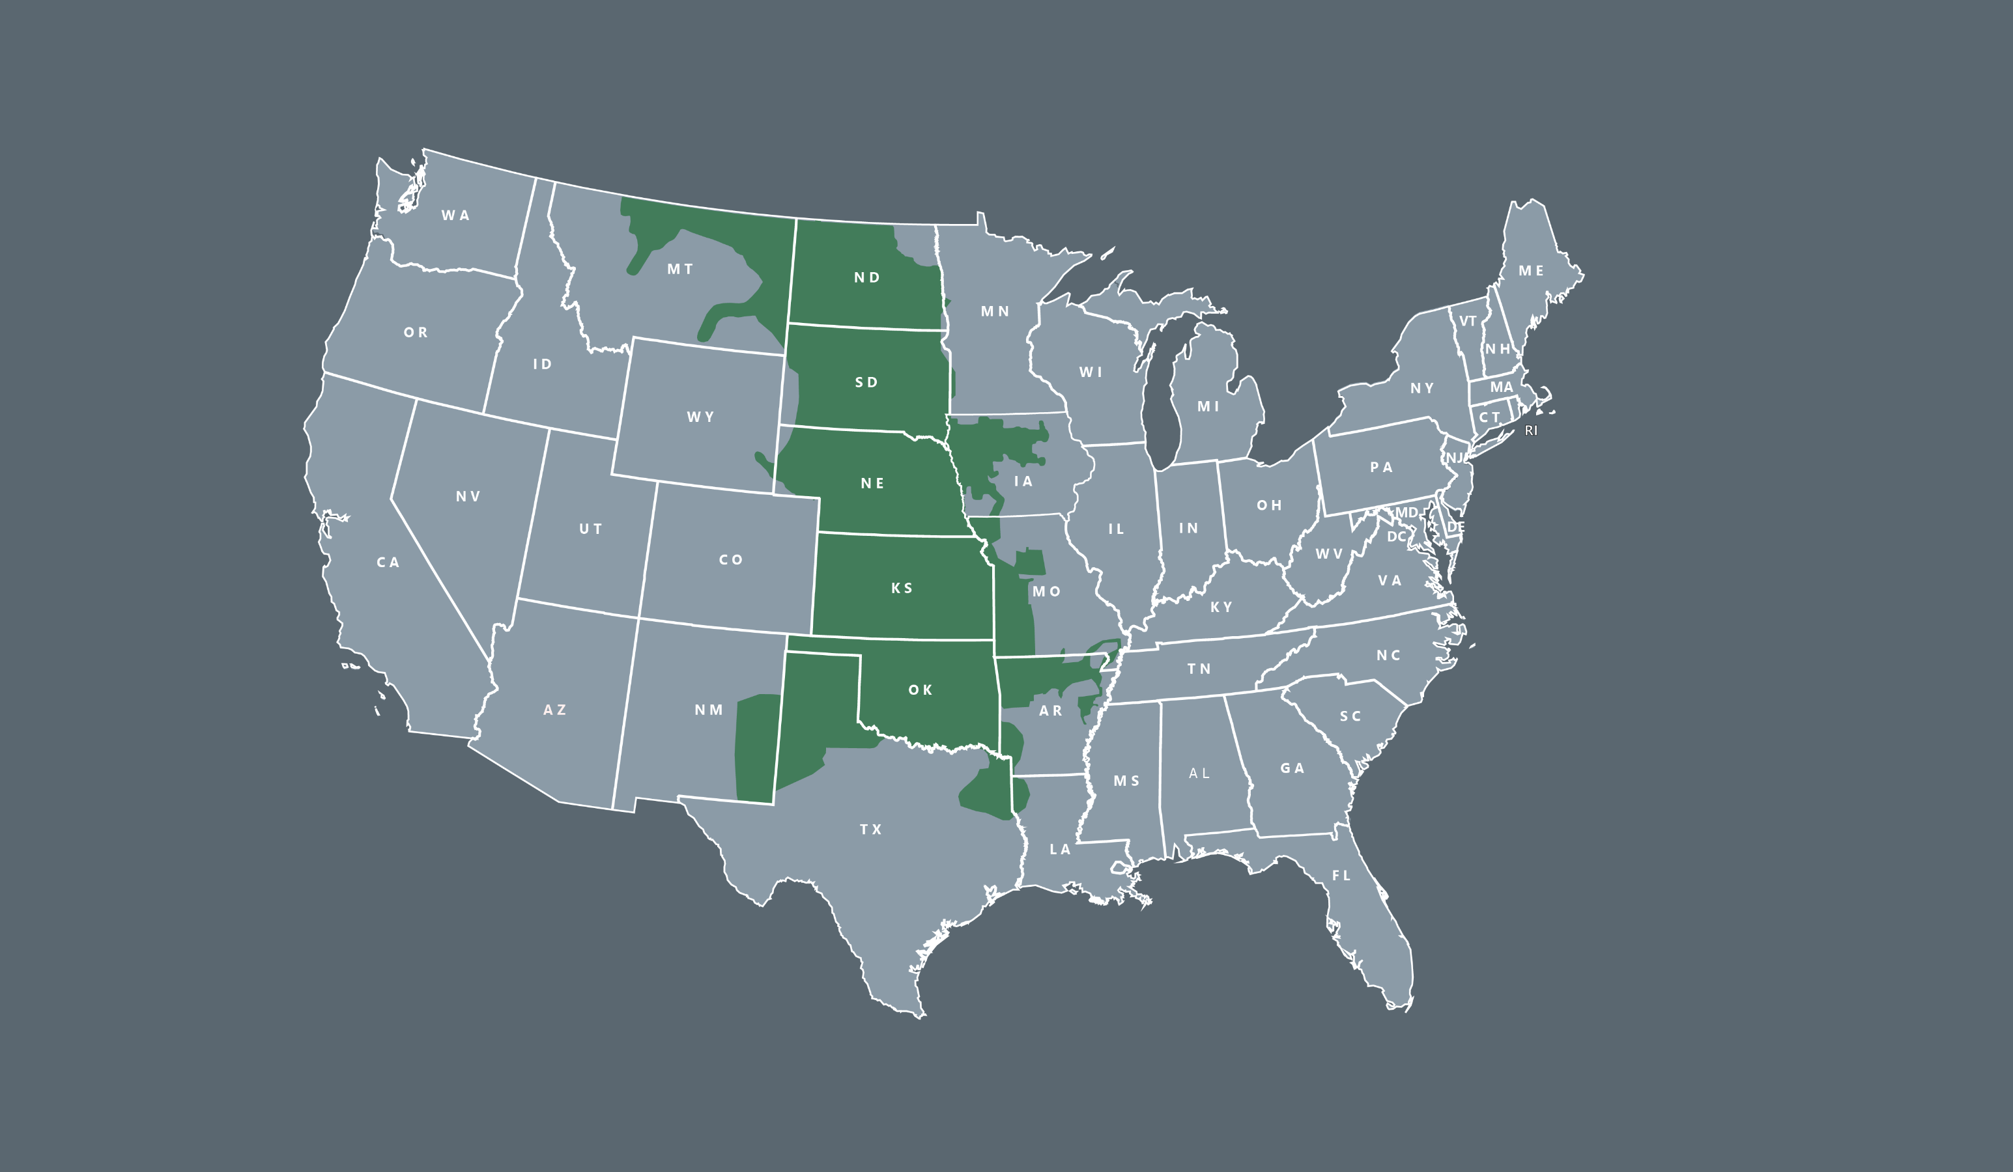
RTO OPERATING REGION
552,885 square mile service territory
~18 million population served
967* generating plants
5,267* substations
* In SPP’s balancing authority area

Slide 6

$3.62 BILLION
Operations and Reliability: $905.2 million
SPP operates from a regional perspective. This reduces costs and required energy reserves and increases efficiency.
Markets: $2.25 billion
SPP’s Integrated Marketplace combines efficient and economic day-ahead, real-time and transmission markets.
Transmission: $446.7 million
SPP’s collaborative, stakeholder-driven transmission planning processes result in robust infrastructure and have rapidly and reliably integrated renewables.
Tariff, Scheduling and Services: $42.9 million
SPP’s industry-leading services and training meet the compliance, settlements, engineering, tariff and scheduling needs of our customers on a regional scale.
2023 SAVINGS AND BENEFITS
Notes:
Two categories significantly increased from our 2021 Member Value Statement. Some of the biggest increases in our calculation were in two categories:
The Operations & Reliability: Reserve Sharing Group Benefit increased from $542M to $817M: The large cost increase in benefits was driven by the significant increase in LMPs which are directly included in the loss of opportunity component part of the calculation. SPP’s changing resource mix also resulted in a region wide capacity reduction.
The second large increase was in our markets: the Legacy Balancing Area vs Production Market benefit increased from $744M to $1,422.6M: The markets benefits significant increase is directly caused by the increase in fuel costs in 2021. SPP was able to optimize capacity commitments and dispatch across our region, creating substantial savings for our members.

Slide 7

Balancing Electric Supply and Demand
SUPPLY/GENERATION
101,310 MW Nameplate Capacity
66,145 MW Accredited Capacity (as of Summer 2024)
DEMAND/LOAD
56,184 MW all-time coincident peak load (8/21/23)
47,157 MW Winter peak (12/22/22)

Slide 8
283,577 GWh 2023 Energy Production by Fuel Type

Slide 9
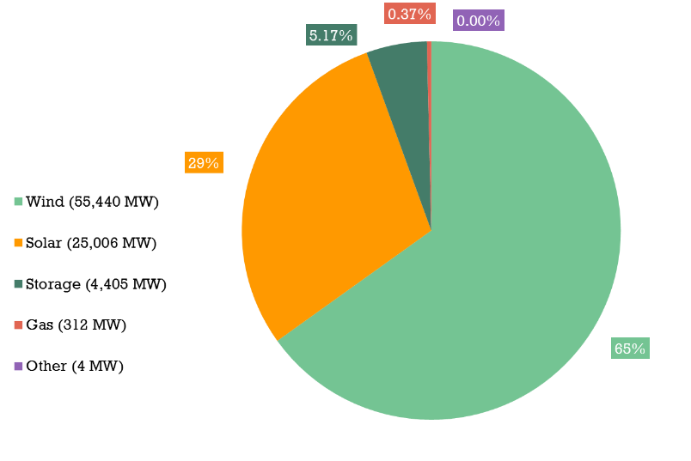
85.3 GW Generator Interconnection Requests under Study As of MAY 1, 2024

Slide 10
stakeholder process & STRATEGY

Slide 11

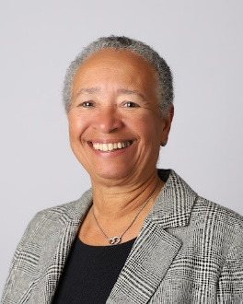
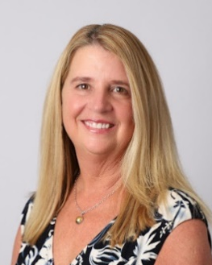
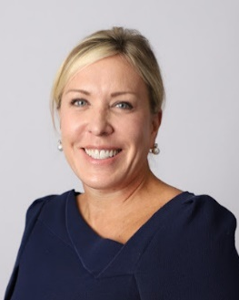
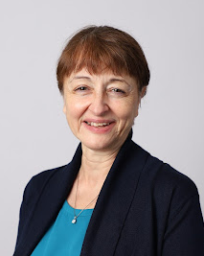
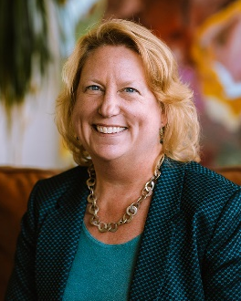
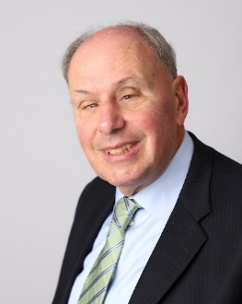
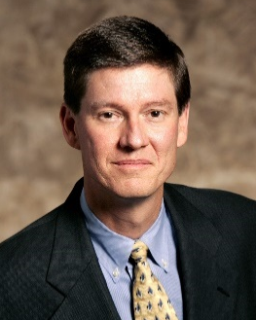


SPP’s Independent Board of directors
John Cupparo, Chair
Elected January 2022, term ends December 2024
Chair, Strategic Planning Committee
Vice Chair, Corporate Governance Committee
Elizabeth Moore, Vice Chair
Elected October 2020, term ends December 2023
Member, Finance Committee
Member, Oversight Committee
Barbara Sugg, President & CEO Elected January 2020
Chair, Corporate Governance Committee
Member, Strategic Planning Committee
Bronwen Bastone
Elected January 2020, term ends December 2025
Chair, Human Resources Committee
Susan Certoma Elected January 2019, term ends December 2024
Member, Finance Committee
Member, Human Resources Committee
Irene Dimitry
Elected January 2024, term ends December 2026
Member, Oversight Committee
Ex Officio, Strategic Planning Committee
Ray Hepper Elected January 2023, term ends December 2025
Chair, Oversight Committee
Member, Human Resources Committee
Ex Officio, Corporate Governance Committee
Stuart Solomon
Elected January 2024, term ends December 2026
Chair, Finance Committee
Member, Oversight Committee
Ben Trowbridge
Elected January 2022, term ends December 2024
Member, Strategic Planning Committee
Member, Oversight Committee
Steve Wright Elected October 2022, term ends December 2025
Member, Strategic Planning Committee

Slide 12
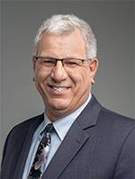
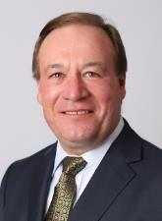



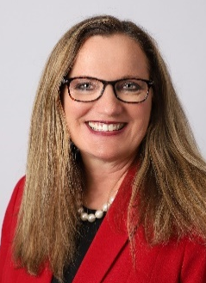
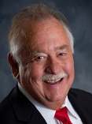

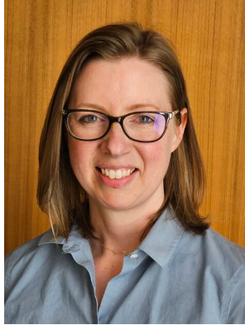

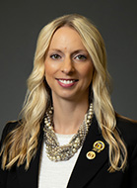
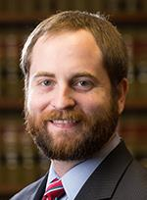
2024 Regional State Committee
John Tuma,
RSC President
Minnesota Public Utilities Commission
Todd Hiett,
RSC Vice President
Oklahoma Corporation Commission
Chuck Hutchison,
RSC Secretary/Treasurer
Nebraska Power Review Board
Randel Christmann
North Dakota Public Service Commission
Lori Cobos
Public Utility
Commission of Texas
Kristie Fiegen
South Dakota Public Utilities Commission
Mike Francis
Louisiana Public Service Commission
Andrew French
Kansas Corporation Commission
Sarah Martz
Iowa Utilities Board
Pat O’Connell
New Mexico Public Regulation Commission
Kayla Hahn
Missouri Public Service Commission
Justin Tate
Arkansas Public Service Commission
* Elected commissioner

Slide 13
SPP’s 114 Members: Independence Through Diversity
114 Members
Updated June 1, 2024
Notes:
SPP has one of the most diverse memberships of any Regional Transmission Organization. This diversity helps ensure independence; we carefully balance diverse interests in our decision-making processes.
Investor Owned Utilities: Traditional vertically-integrated utilities
Cooperatives: Rural electric cooperatives
Municipals: Cities
State Agencies: State-created agencies that own/operate facilities
Independent Power Producers/Wholesale Generation: Entities that develop and own generation, but don’t own transmission
Independent Transmission Companies - Entities that develop and own transmission, but don’t own generation
Marketers: Entities that own no facilities or transmission, but buy/sell excess capacity
Federal Agencies
Large Retail Customers

Slide 14
Collaborative stakeholder process
Board of Directors/Members Committee
Regional State Committee
Membership
Staff
Committees
Cost Allocation Working Group
Markets & Operations Policy
Working Groups
Corporate Governance
User Forums
500+ stakeholders drive decisions & strategic direction
Rosters represent member diversity
Open stakeholder forums
Finance
Human Resources
Advisory Groups
Oversight
Advises Board & Committees as needed
Strategic Planning
Notes:
More than 500 stakeholders are involved in SPP’s organizational structure of committees, working groups, and ad hoc task forces. This member involvement drives SPP’s decision-making and strategic direction.
Any and all opinions are heard loudly and clearly in organizational group meetings. The rosters of our organizational groups match the diverseness of the membership, requiring representatives from across the footprint and recognizing different member types and sizes.

Slide 15
Transmission

Slide 16
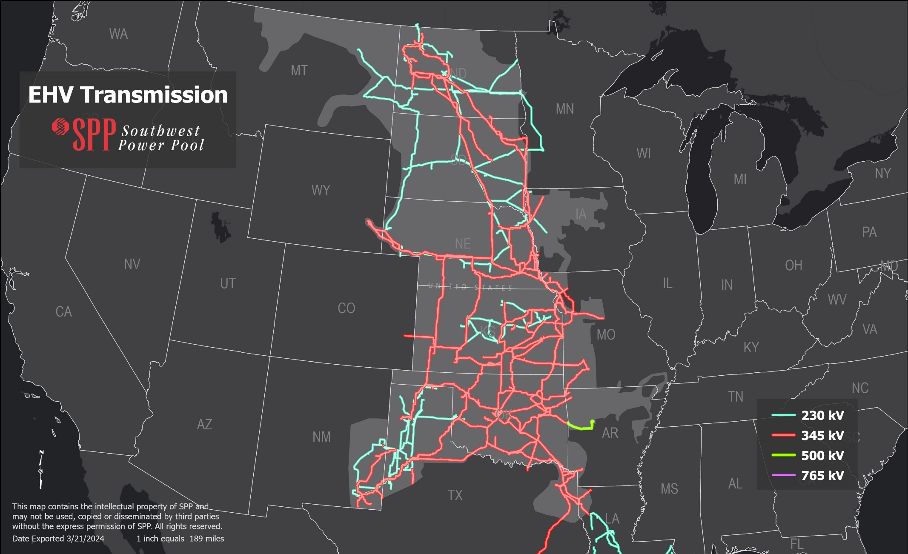
MILES OF TRANSMISSION: 72,820
69 kV 19,606
115 kV 17,032
138 kV 9,943
161 kV 5,677
230 kV 7,817
345 kV 12,655
500 kV 91
As of January 29, 2024

Slide 17
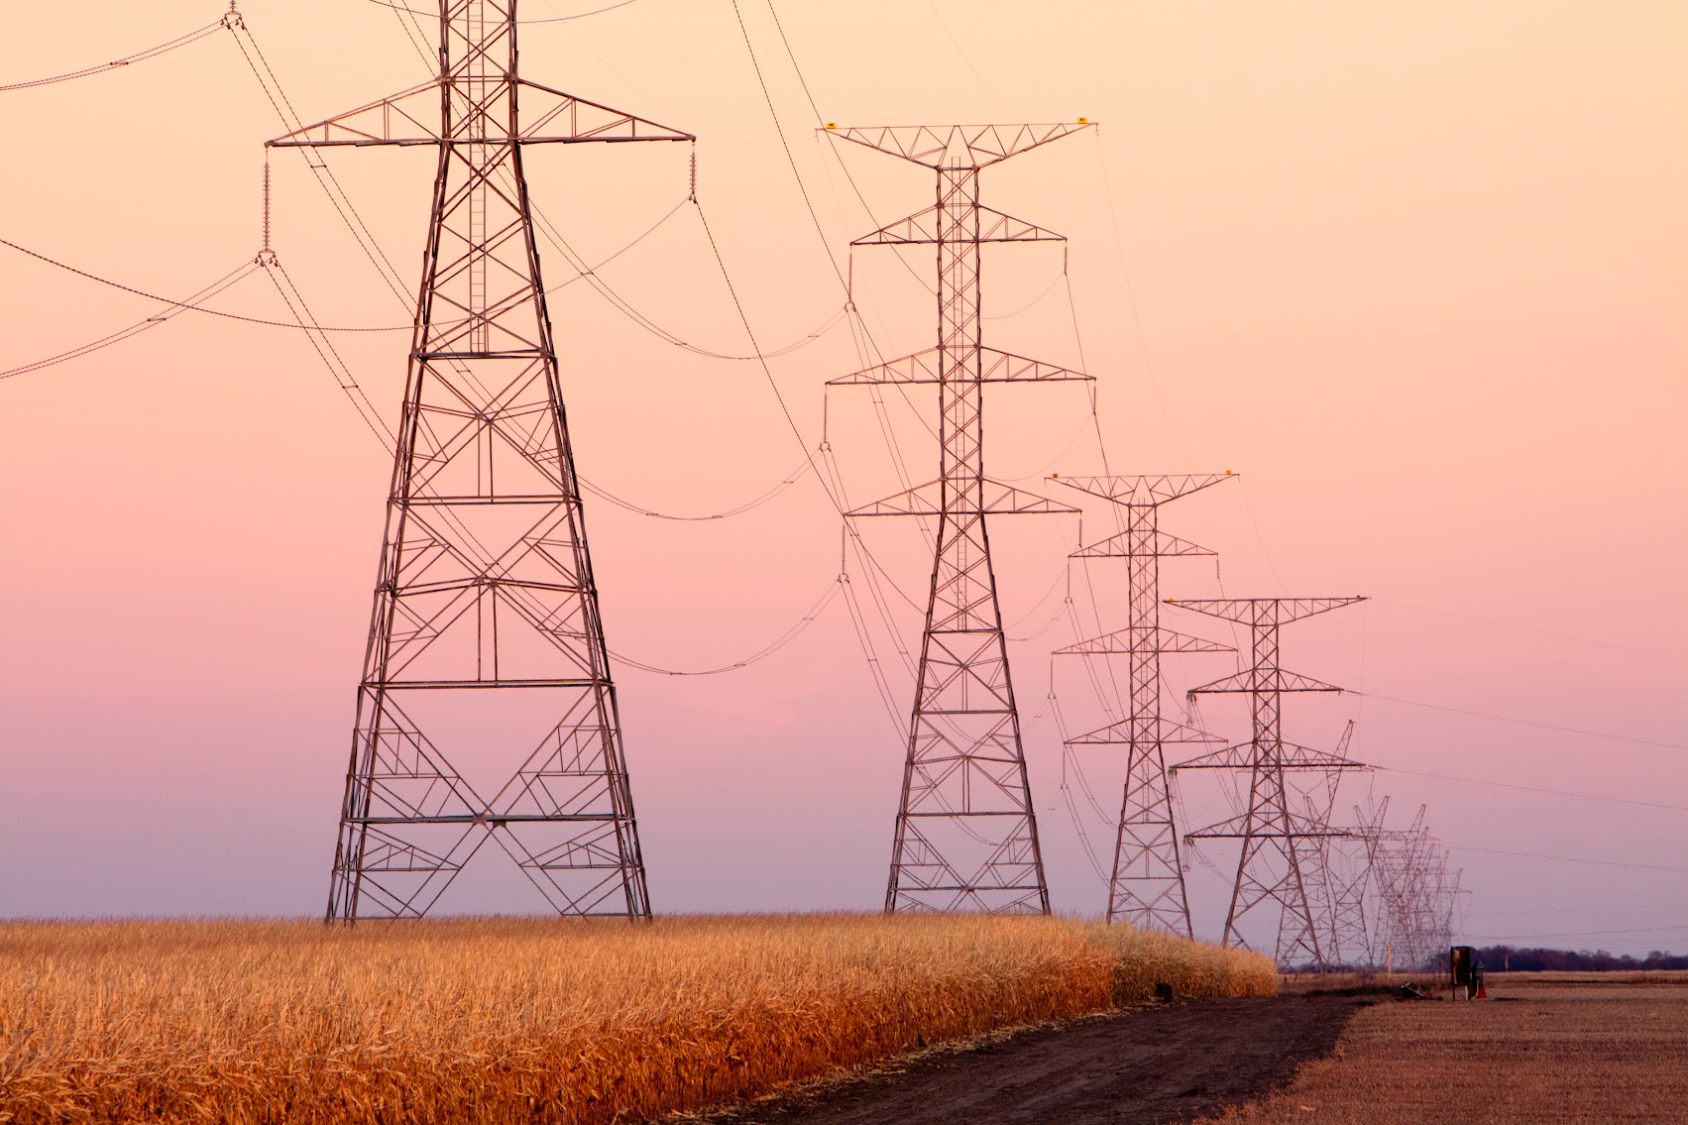
Who Pays for Transmission Projects?
Sponsored: Project owner builds and receives credit for use of transmission lines
Directly-assigned: Project owner builds and is responsible for cost recovery and receives credit for use of transmission lines
Highway/Byway: Most SPP projects paid for under this methodology
Voltage | Region Pays | Local Zone Pays
300 kV and above | 100% | 0%
above 100 kV and below 300 kV | 33% | 67%
100 kV and below | 0% | 100%

Slide 18
SPP Services in the West

Slide 19

RTO West
7 organizations joining RTO in 2026; expected $344M annual savings for new & existing members
Western Energy Imbalance Service (WEIS) Market
Launched Feb. 2021; total market load 13.5GW
Markets+
New real-time/day-ahead market in development with western parties
Western Reliability Coordination Service
Maintaining reliability for 13 western transmission operators
Western Interconnection Unscheduled Flow Mitigation Plan
Helping 6 western organizations manage grid congestion
Western Resource Adequacy Program Operator
Partnering with Western Power Pool to ensure resource adequacy
Reinforce system reliability
Achieve clean energy goals
New opportunities to trade low-cost power
Provide economic benefits
Maintain resource adequacy

Slide 20
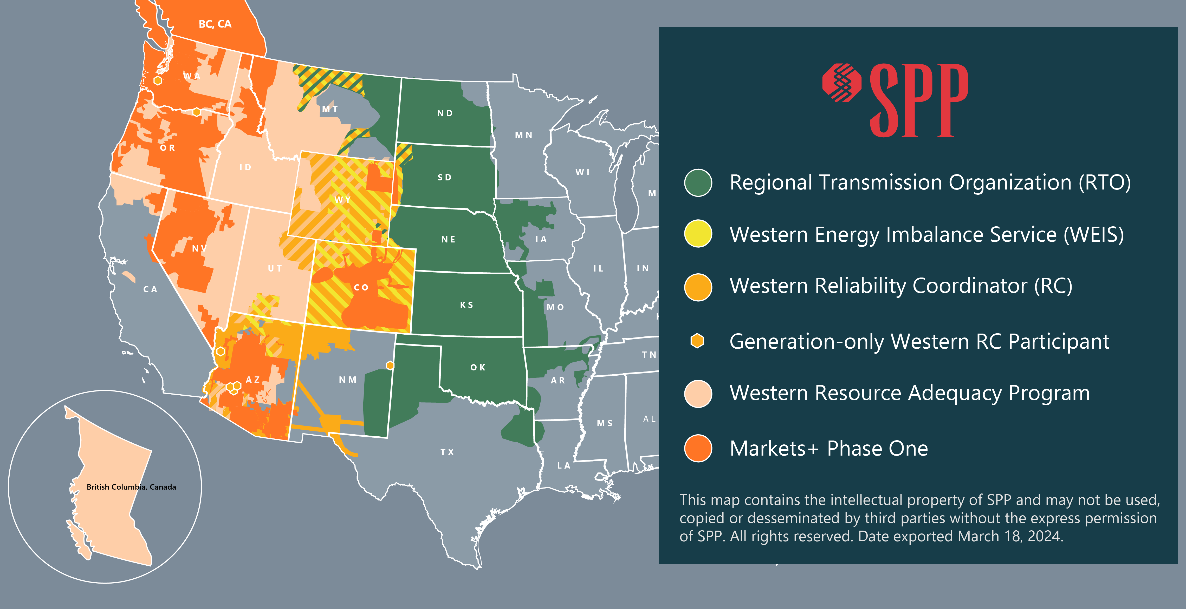
SPp Western services

Slide 21
RTO Expansion into the West

Slide 22
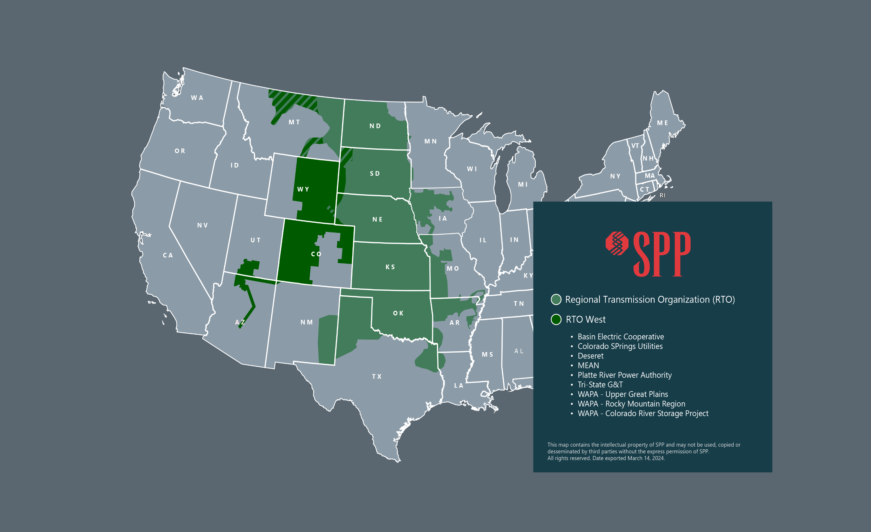

MOPC Approval | April 16, 2024
SPP Board Approval | May 7, 2024
Filing At FERC | June 3, 2024
22

Slide 23
SPP RTO Expansion into the west
April 1, 2026 Go-Live
Committed Members: Colorado Springs Utilities, Deseret G&T Cooperative, Platt River Power Authority, MEAN, Tri-State G&T, Basin Electric Cooperative, WAPA: CRSP, RMR, UGP
Governance Changes for the expanded SPP
Single RTO using existing Tariff
Very limited governing document changes
Expect limited West only working groups

Slide 24
RTO Expansion into the western Interconnect
One Balancing Authority with Two Balancing Authority Areas
Eastern Interconnection
Western Interconnection
Single market solution optimized across DC ties
Up to 510 MW of bi-directional DC tie capacity
Current RTO Governance structure with necessary expansion to be inclusive of Western Interconnection membership

Slide 25
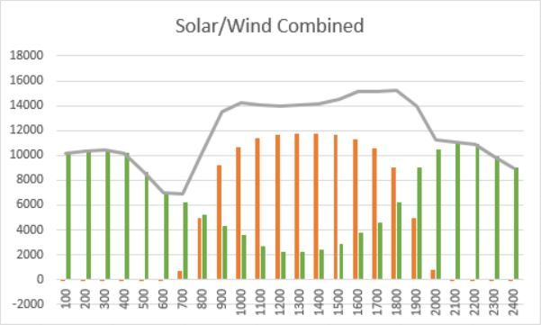
Expansion WILL Benefit CURRENT & FUTURE Members
Expansion of footprint increases market value.
Eastern wind and western solar resources are highly complimentary, creating potential for economic and reliability benefits.
Access to western resources could have significant impacts during reliability events.
Administrative fee costs will be spread among more members.
Example: SPP wind and CAISO solar on August 5, 2020.

Slide 26


OTHER BENEFITS
Positive Environmental Impact
SPP’s centralized markets and transmission expansion improved access to renewables and reduced CO₂ emissions by 22% since 2014.
Improved Public Policy
SPP helps members meet state clean energy goals, use stakeholder processes to create mutually beneficial policies and more. Economic Development
Transmission expansion facilitated by SPP results in billions of capital investment and thousands of skilled jobs for local economies. Our competitive wholesale rates are attracting new business to our region.


Slide 27
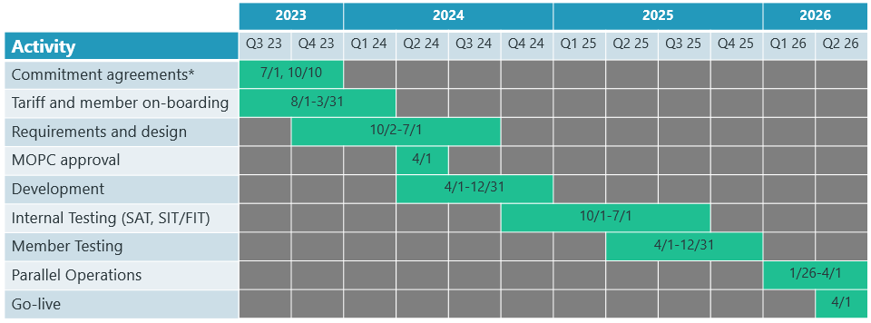
High-level Timeline – April 1, 2026

Slide 28
SPP Markets+

Slide 29
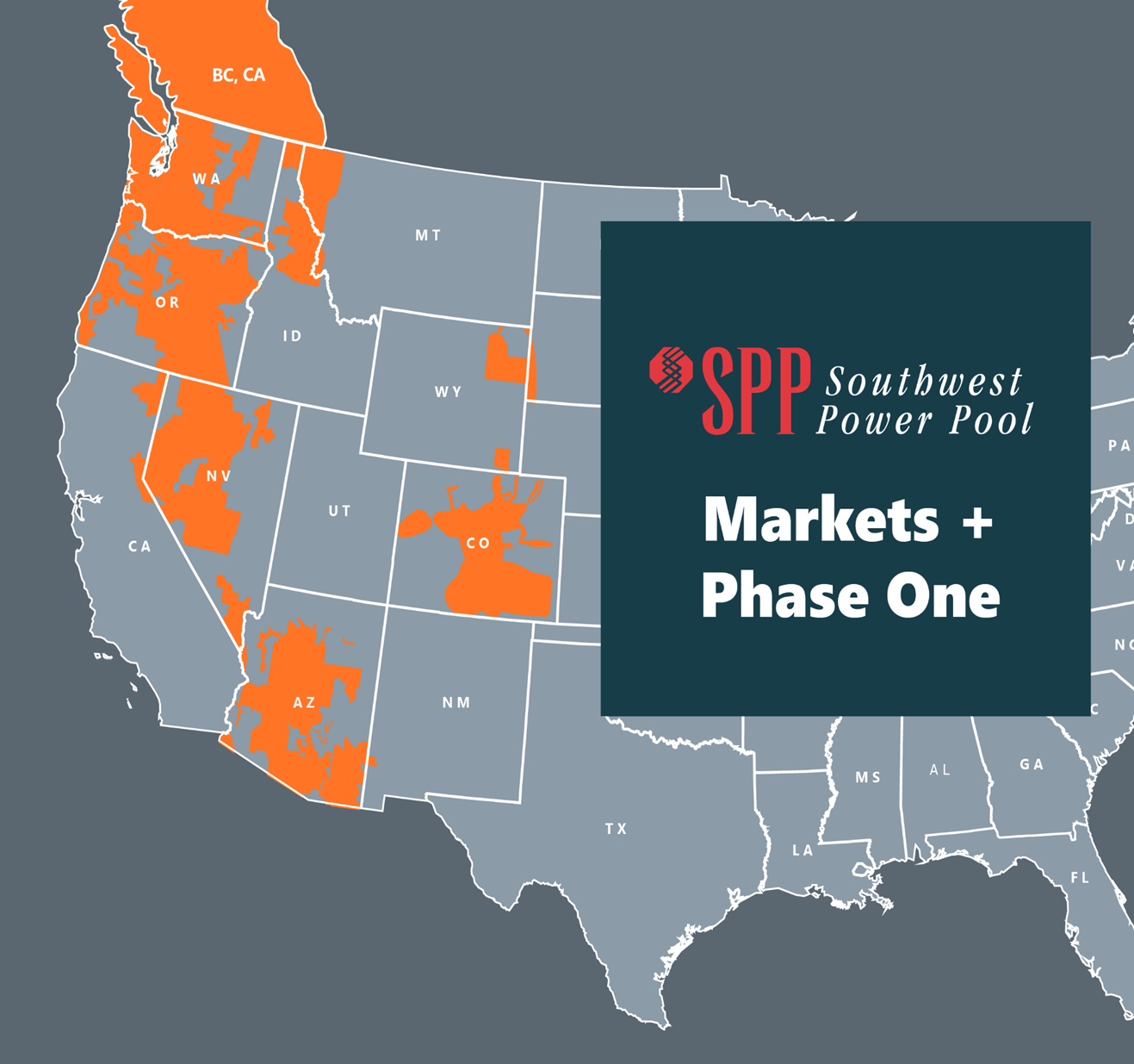
About Markets+
MARKETS+ PHASE 1
Day-Ahead and Real-Time Market Services
Separate footprint and services from the RTO expansion
Tariff Filed at FERC: March 29, 2004
Requested FERC Order: July 31, 2024

Slide 30
Markets+ High Level Timeline

Slide 31
Markets+ Governance

Slide 32



MARKETS+ GOVERNANCE
Designed by the West, for the West.
Under the SPP governance model, stakeholders drive solutions evaluation, decisions and timeframe. Markets+ embeds the SPP approach to governance that provides market participants voting rights on all market design issues. SPP collaborated with hundreds of Western stakeholders to develop the detailed Markets+ proposal, and together they have reached agreement on many issues that have previously been intractable. Markets+ includes a new board, independent from any market influence and chosen by stakeholders, that will oversee final market design and tariff filing.
Since April 2023, the stakeholder-led Markets+ working groups have developed tariff language approved by the Markets+ Participant Executive Committee (MPEC) at a 97.6% approval rating.
Independent governance ensures equity in the benefits to regionalization by allowing stakeholder voice in how benefits and value are distributed among participants.
97.6%

Slide 33
SPP Board of Directors (SPP BOD)
Markets+ Governance Structure as included in draft governing document
Markets+ Independent Panel (MIP)
Markets+ State Committee
Markets+ Participants Executive Committee (MPEC)
Working Groups
Operations Reliability
Seams
Market Design
Markets+ Nominating and Governance Committee
Ad hoc Task Forces

Slide 34
SEAMS

Slide 35




Seams framework
Proper incentives are in place for seams negotiations to yield favorable outcomes for consumers
CREATES TRANSPARENCY
IMPROVES MARKET DESIGN AND PERFORMANCE
BOLSTERS RELIABILITY IN TIMES OF GENERATION OR TRANSMISSION SCARCITY
Extensive mutually beneficial trades are and have been taking place between California and other western states for years. Establishing two markets does not erode the value of that trade, it enhances it.

Slide 36

Seams framework
As an independent Market Operator that exists for the sole purpose of providing value to its customers, we will negotiate and collaborate with peer Market Operators to retain and enhance the value of trade between systems.
An operator with obligations to a specific class of customers will be challenged to negotiate for the equitable interests of all of its customers.

